Slide 1

Python: Multiple Regression
Žydrūnė Kelpšaitė
Data Analyst
2026

Slide 2
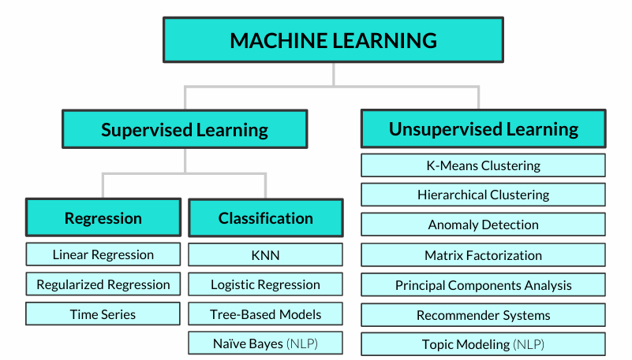
COMMON ALGORITHMS

Slide 3
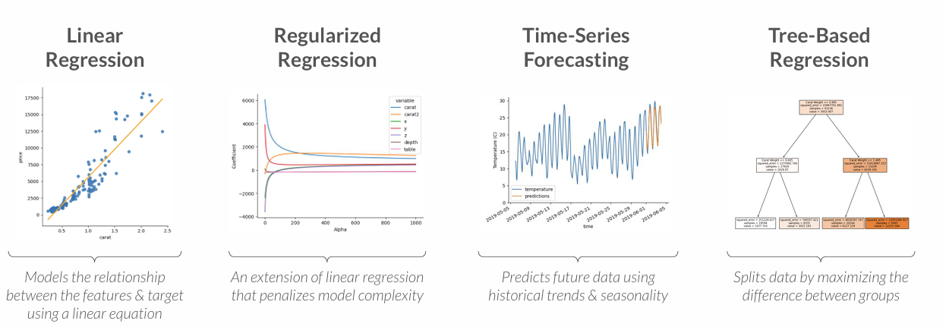
TYPES OF REGRESSION
These are some of the major types of regression modeling techniques
Even though logistic regression (which you may have heard of) has “regression” in its name, it’s actually a classification modeling technique!

Slide 4
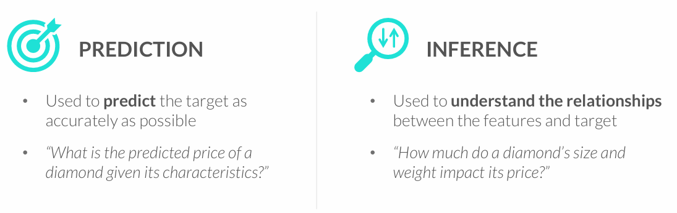
GOALS OF REGRESSION
Regression models are used for two primary goals: prediction and inference
• The goal shapes the modeling approach, including the regression algorithm used, the complexity of the model, and more
You often need to strike a balance between these goals – a model that is very inaccurate won’t be too trustworthy for inference, and understanding the impact that variables have on predictions can help make them more accurate

Slide 5
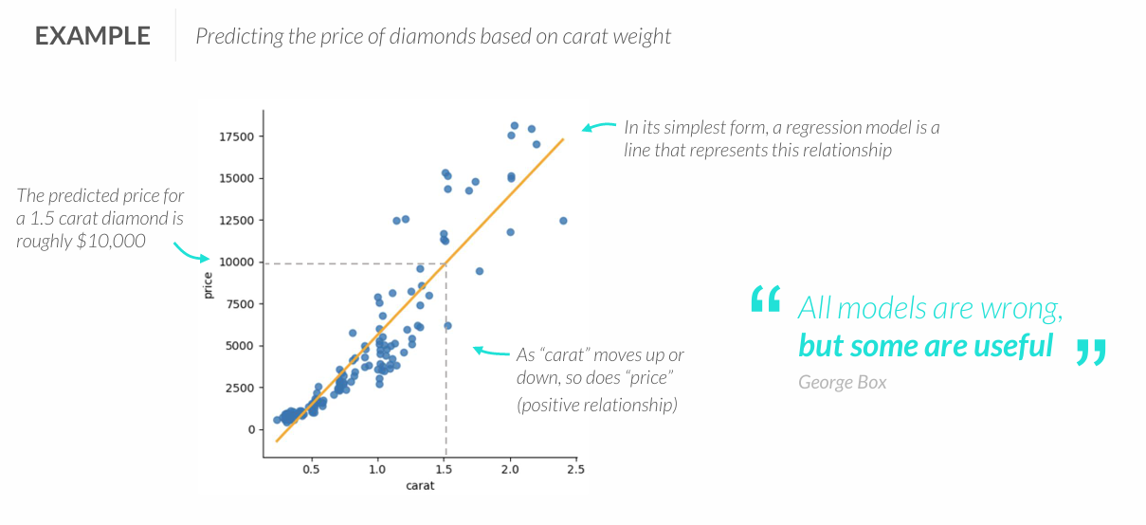
REGRESSION 101
Regression analysis is supervised learning technique used to predict a numeric variable (target) by modeling its relationship with a set of other variables (features)

Slide 6
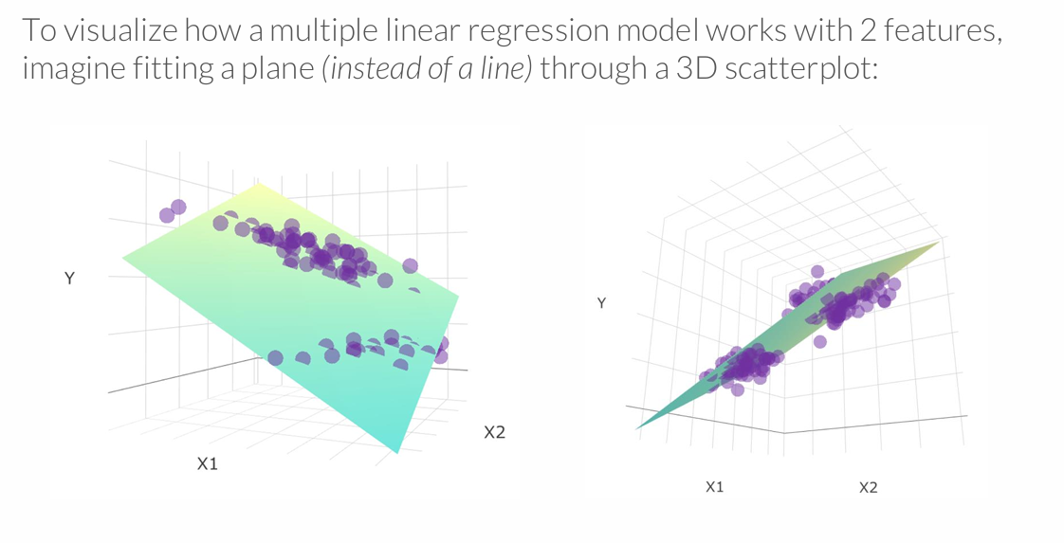
MULTIPLE LINEAR REGRESSION MODEL
Multiple regression can scale well beyond 2 variables, but this is where visual analysis breaks down – and one reason why we need machine learning!

Slide 7
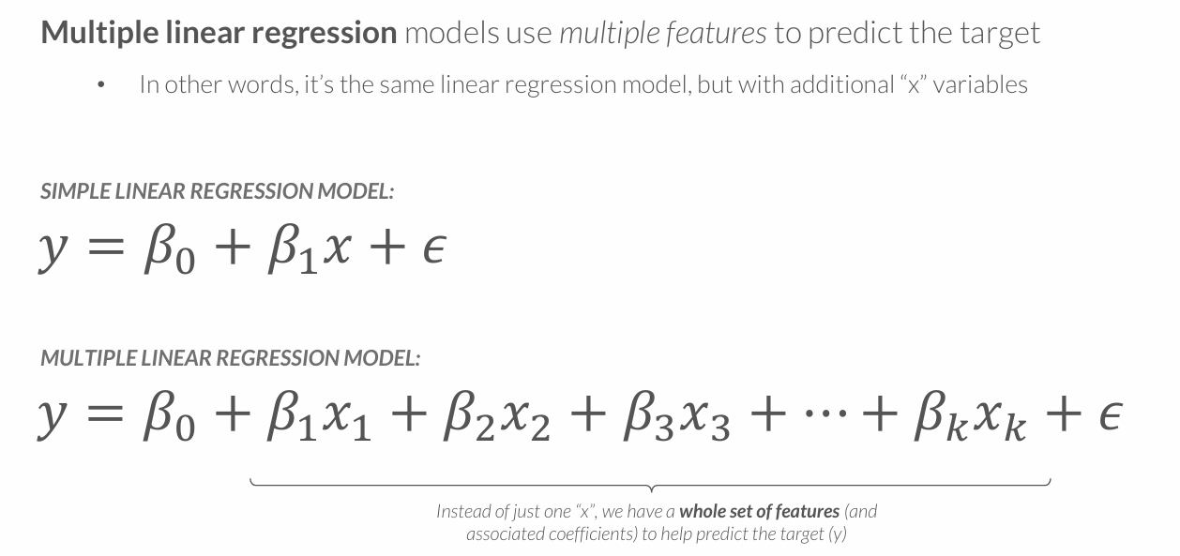
MULTIPLE LINEAR REGRESSION

Slide 8
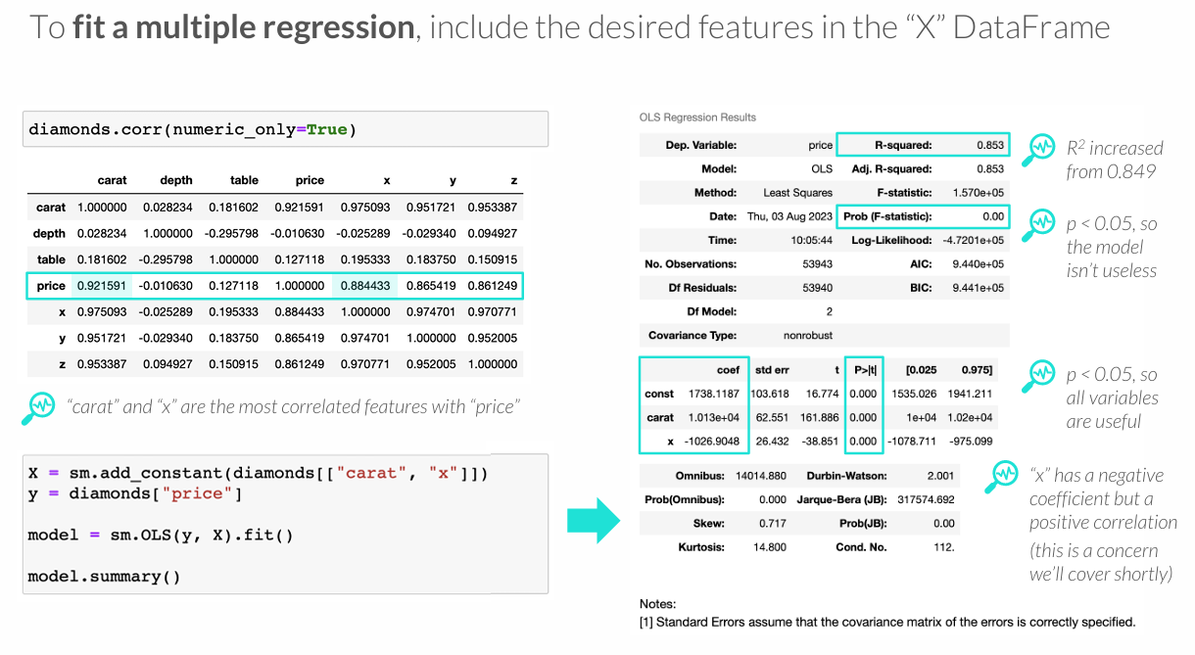
FITTING A MULTIPLE REGRESSION

Slide 9
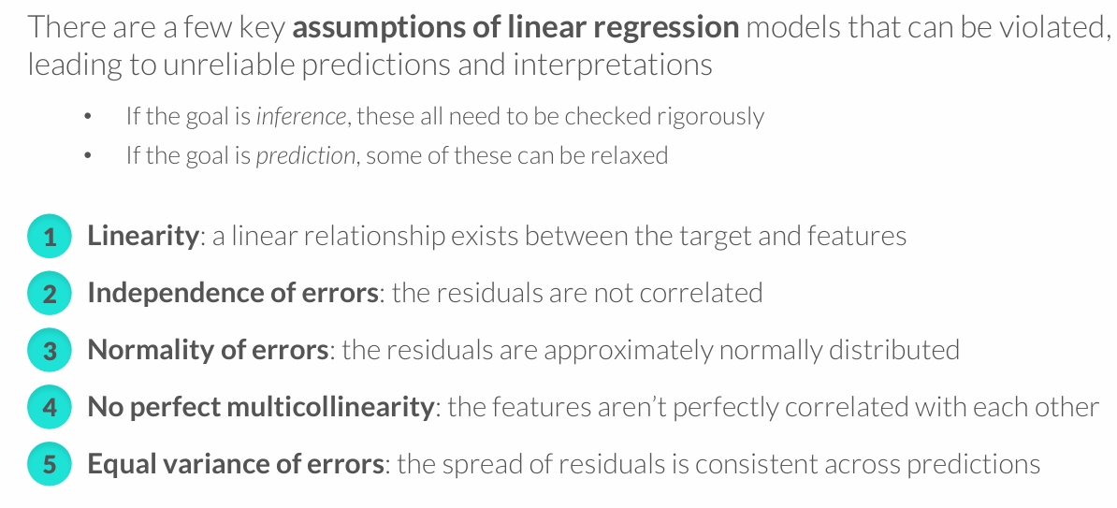
ASSUMPTIONS OF LINEAR REGRESSION

Slide 10
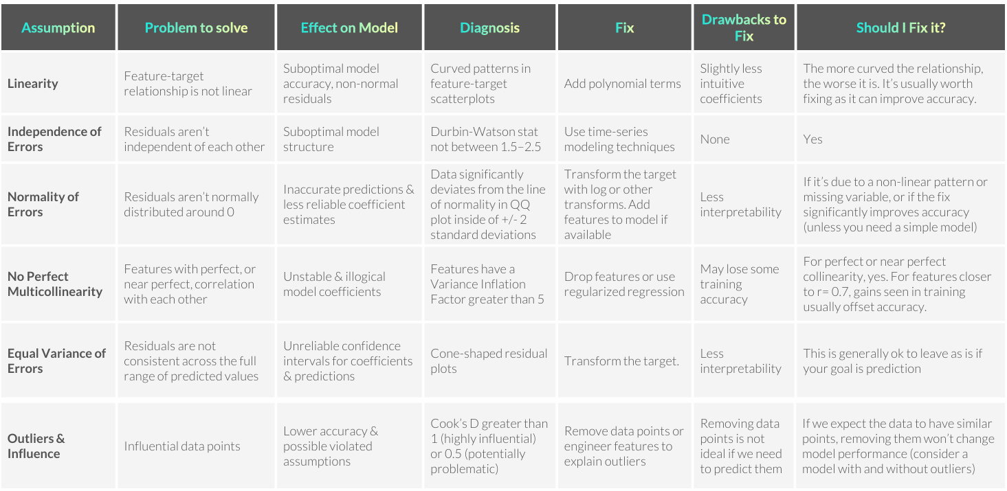

Slide 11
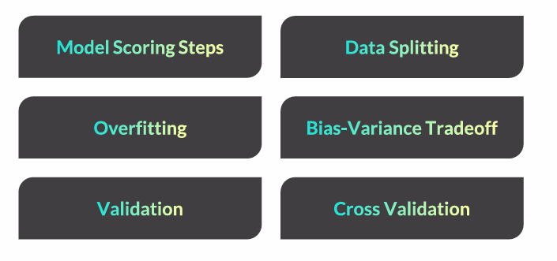
MODEL TESTING & VALIDATION

Slide 12
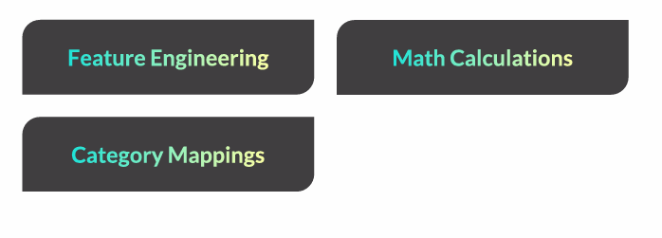
FEATURE ENGINEERING

Slide 13
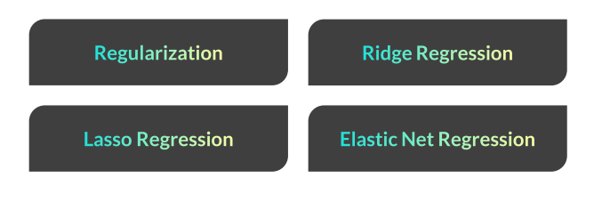
REGULARIZED REGRESSION

Slide 14
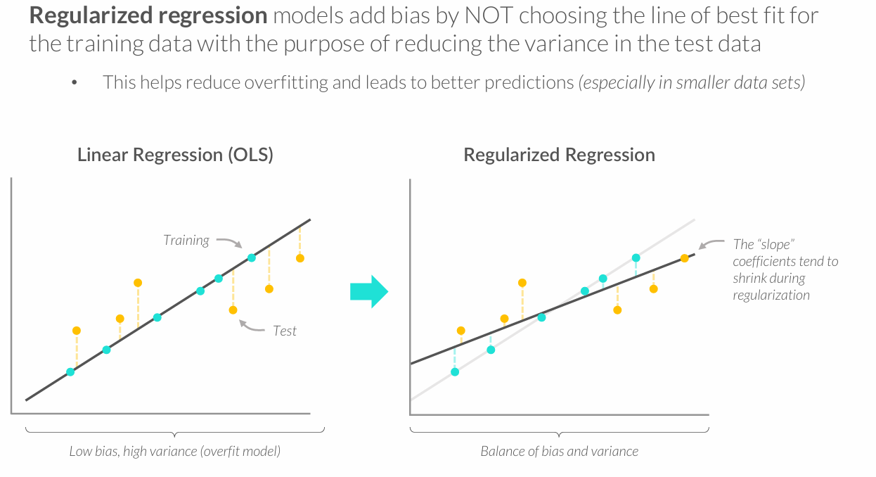
REGULARIZED REGRESSION

Slide 15
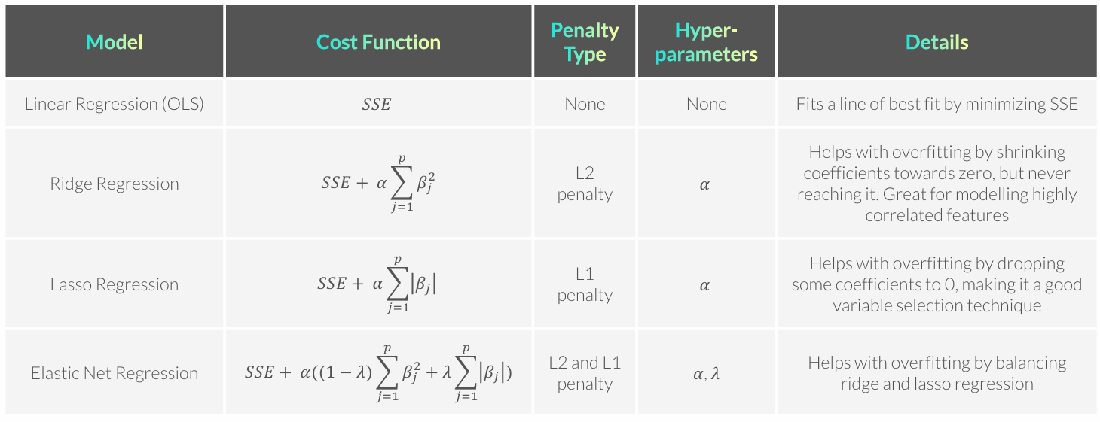
REGULARIZED REGRESSION MODELS

Slide 16
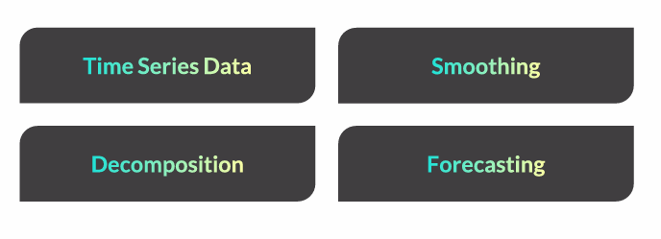
TIME SERIES ANALYSIS

Slide 17
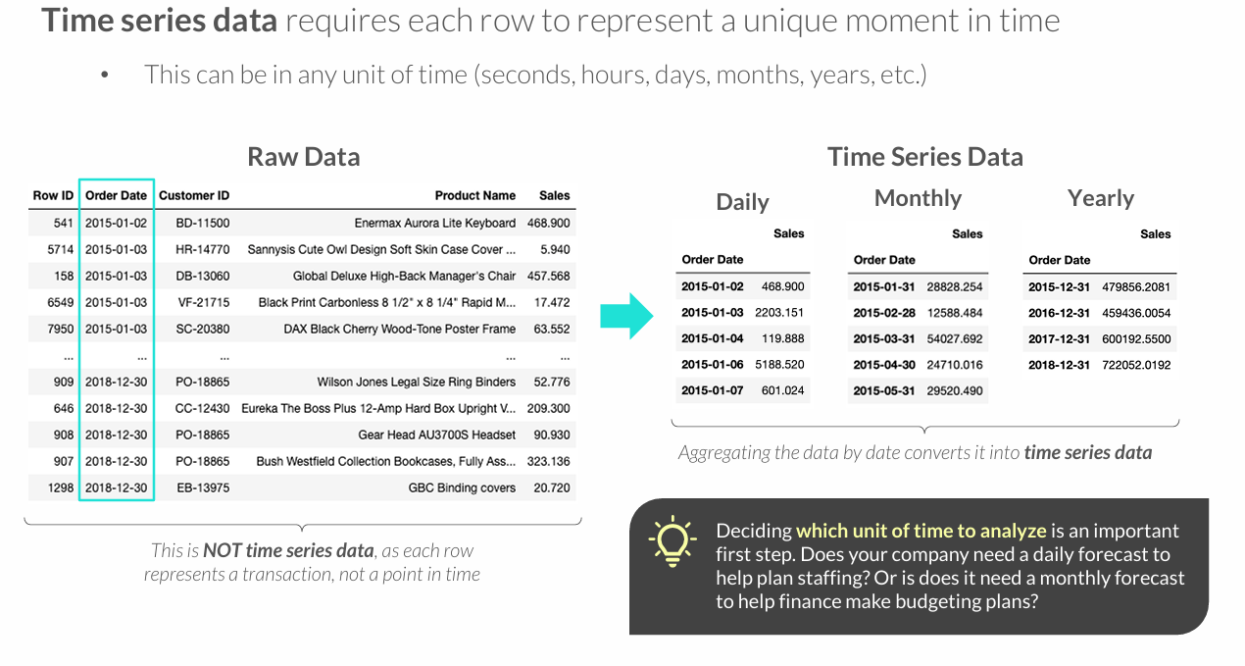
TIME SERIES DATA

Slide 18
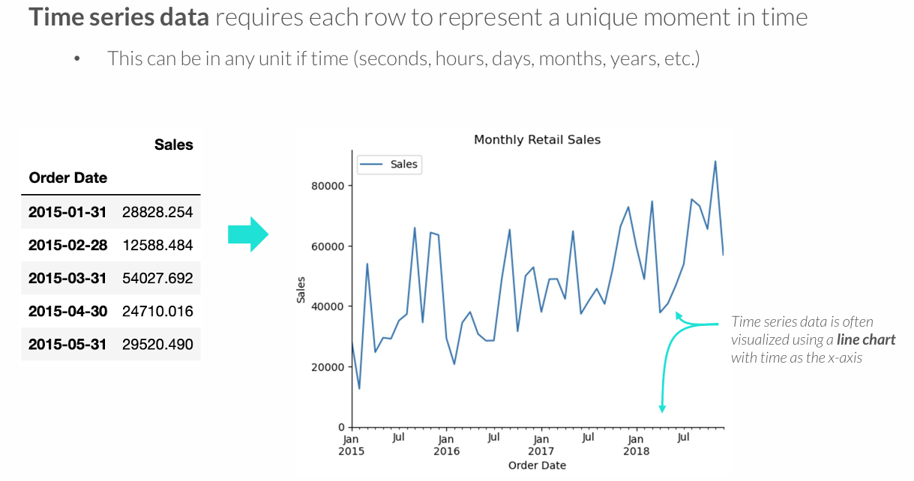
TIME SERIES DATA

Slide 19
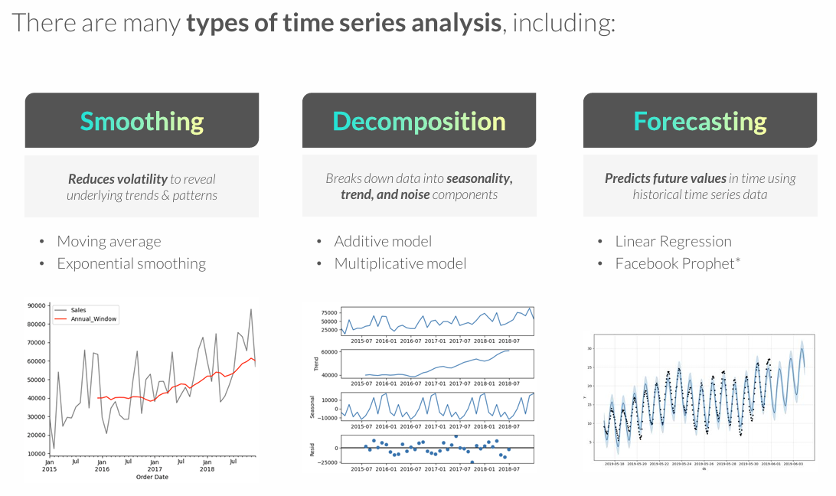
TYPES OF TIME SERIES ANALYSIS

Slide 20
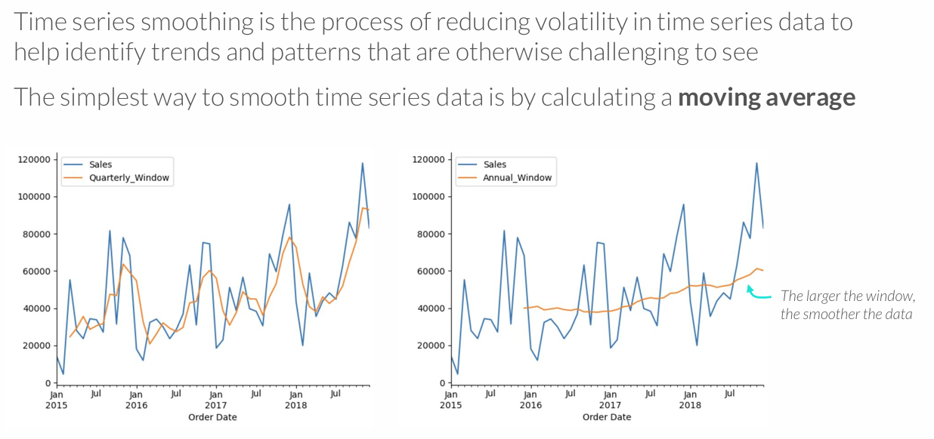
MOVING AVERAGE
Align your windows with intuitive seasons: with monthly data, look at quarters or years, with daily data look at weekly or monthly, etc.

Slide 21
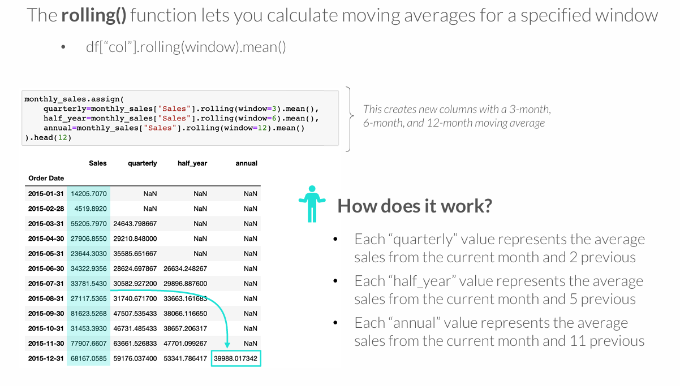
MOVING AVERAGE

Slide 22
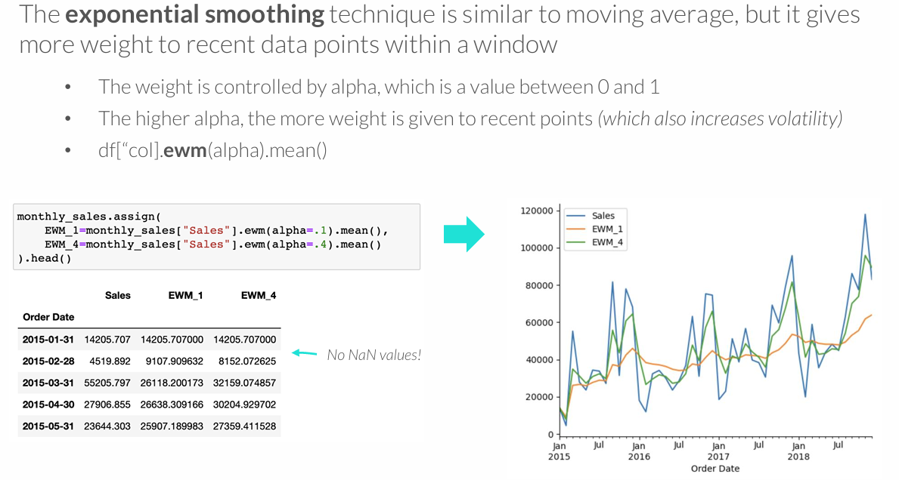
EXPONENTIAL SMOOTHING

Slide 23
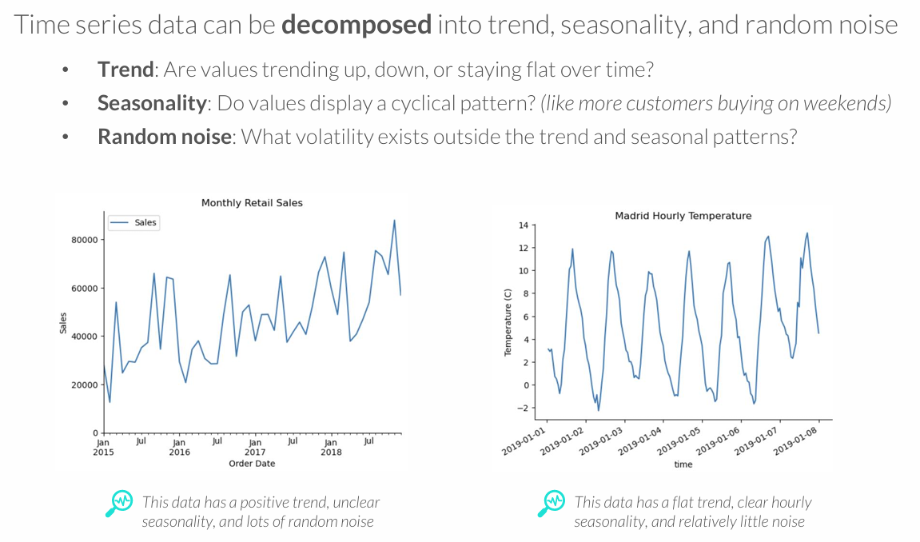
DECOMPOSITION

Slide 24
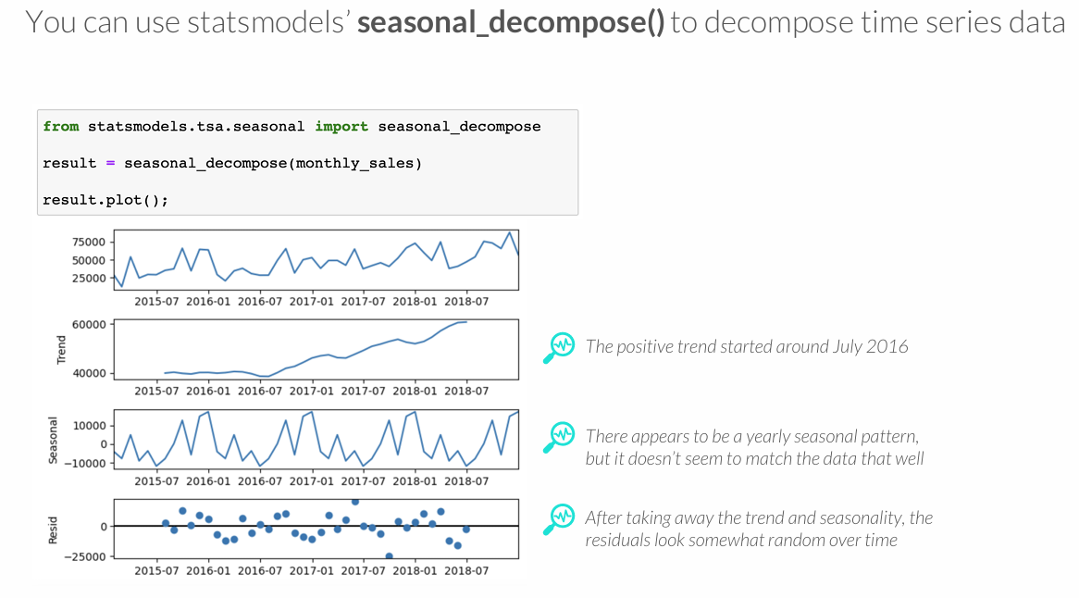
DECOMPOSITION

Slide 25
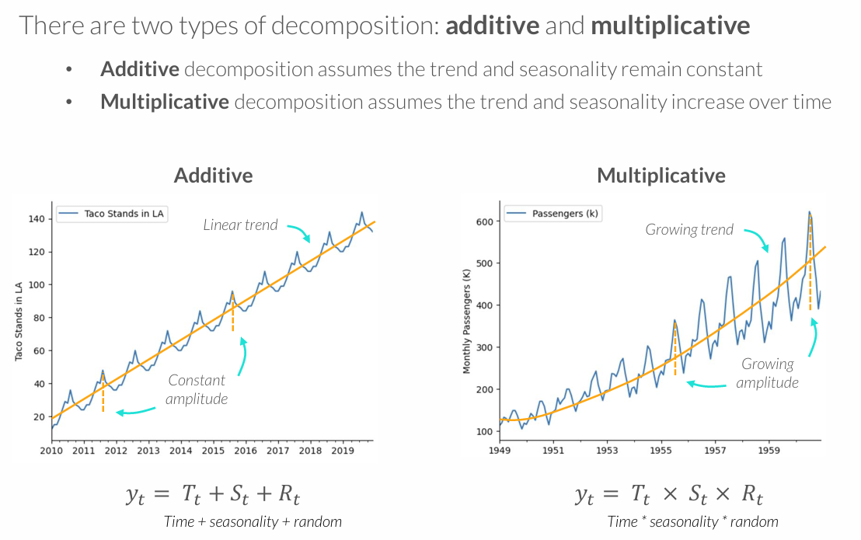
TYPES OF DECOMPOSITION

Slide 26
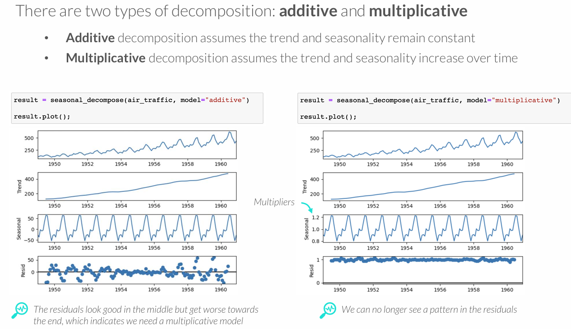
TYPES OF DECOMPOSITION

Slide 27
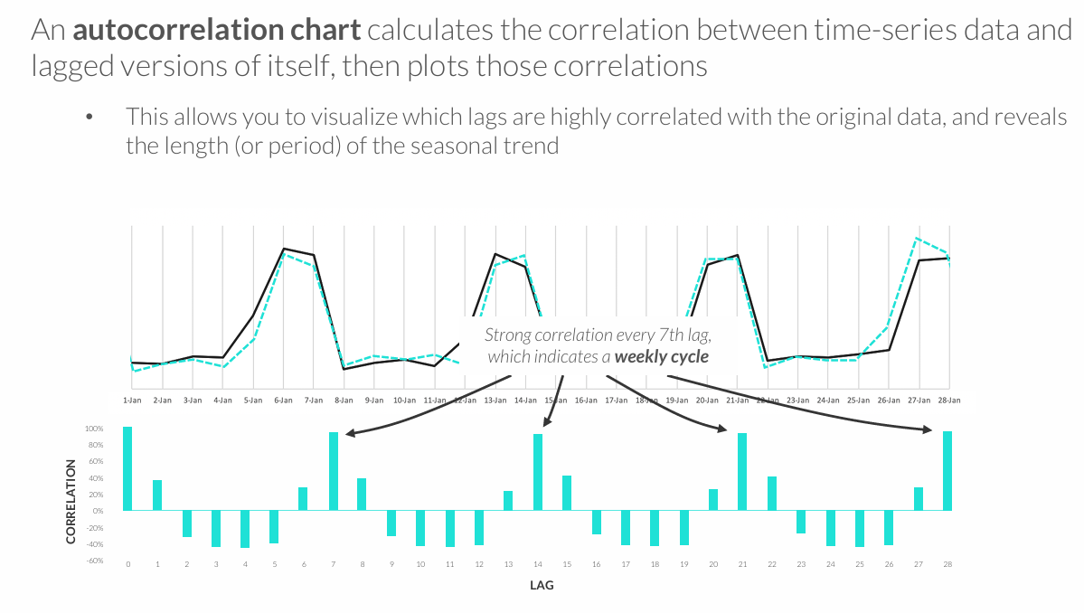
AUTOCORRELATION CHART

Slide 28
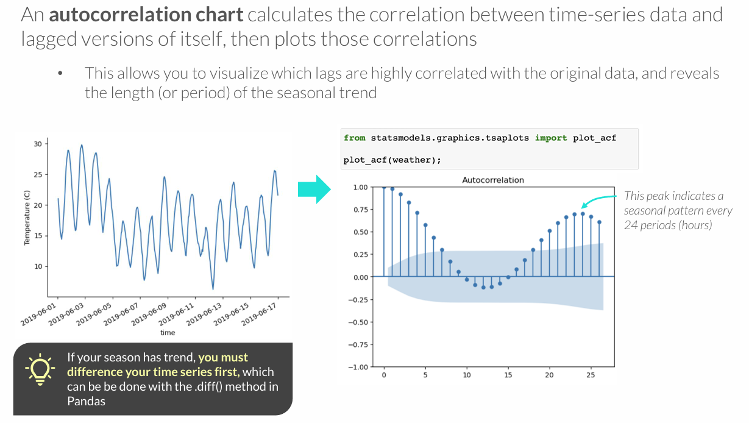
AUTOCORRELATION CHART
Notes:
.diff() apskaičiuoja skirtumą tarp dabartinės ir ankstesnės reikšmės - pašalina bendrą augimo kryptį ir palieka tik pokyčius.
Formulė paprastai:
Nauja reikšmė = Y(t) − Y(t−1)
Pvz.:
Pardavimai: 100, 110, 125, 140
Po .diff() gauname: NaN, 10, 15, 15
Tai reiškia: kiek padidėjo ar sumažėjo reikšmė lyginant su ankstesniu laikotarpiu.

Slide 29
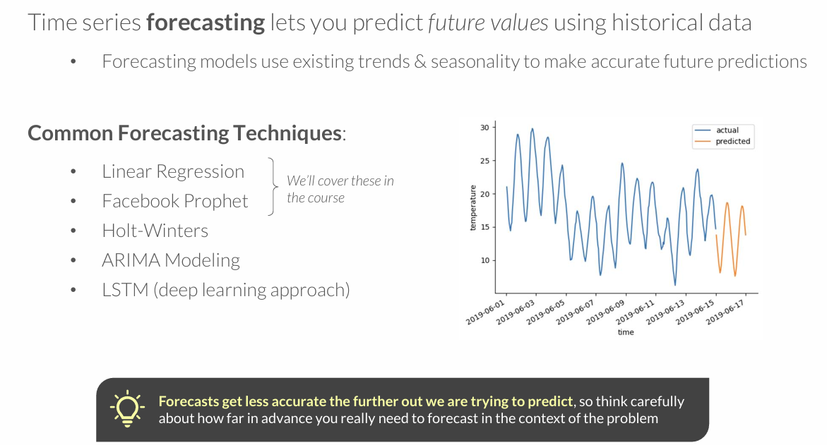
FORECASTING

Slide 30
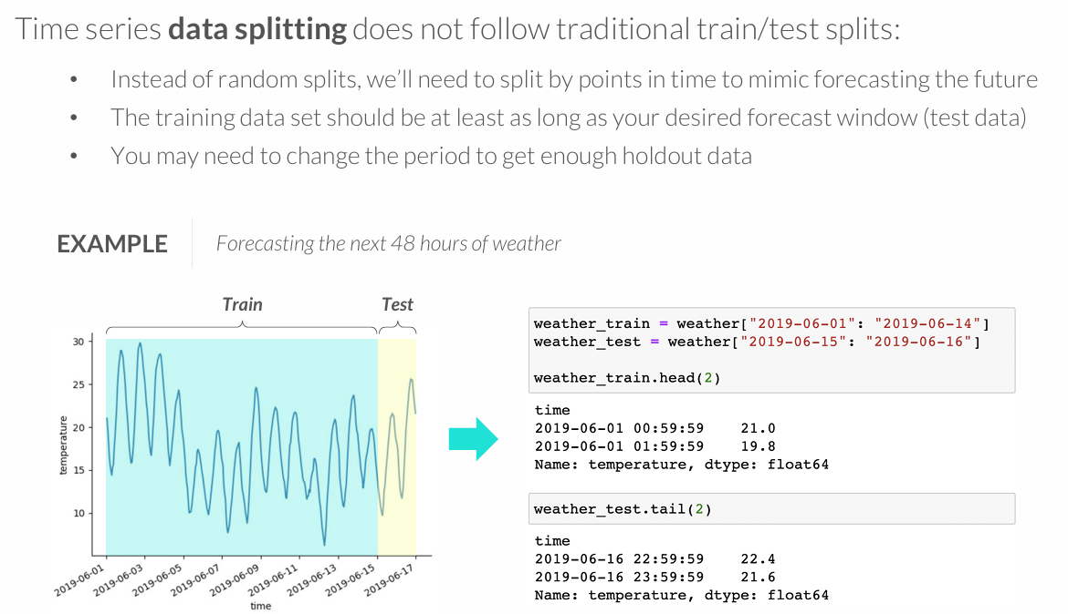
DATA SPLITTING

Slide 31
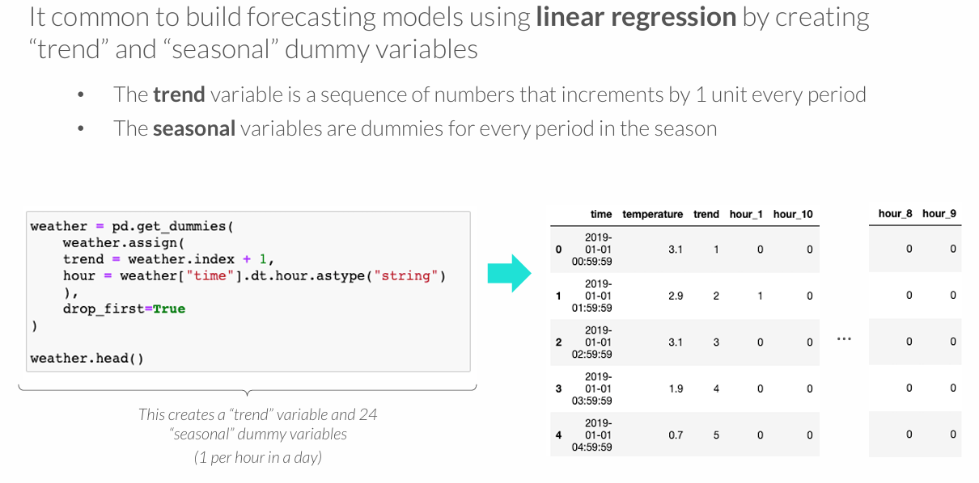
LINEAR REGRESSION WITH TREND & SEASON

Slide 32
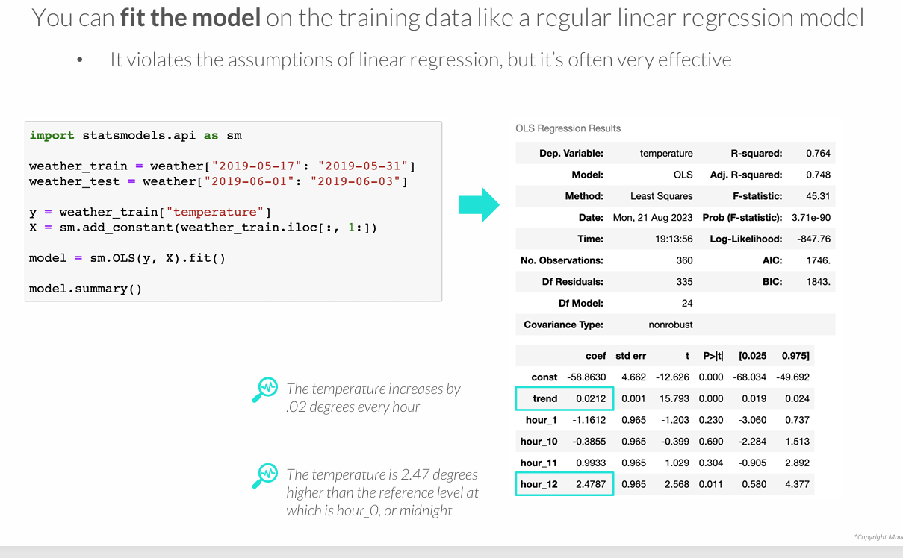
FITTING THE MODEL

Slide 33
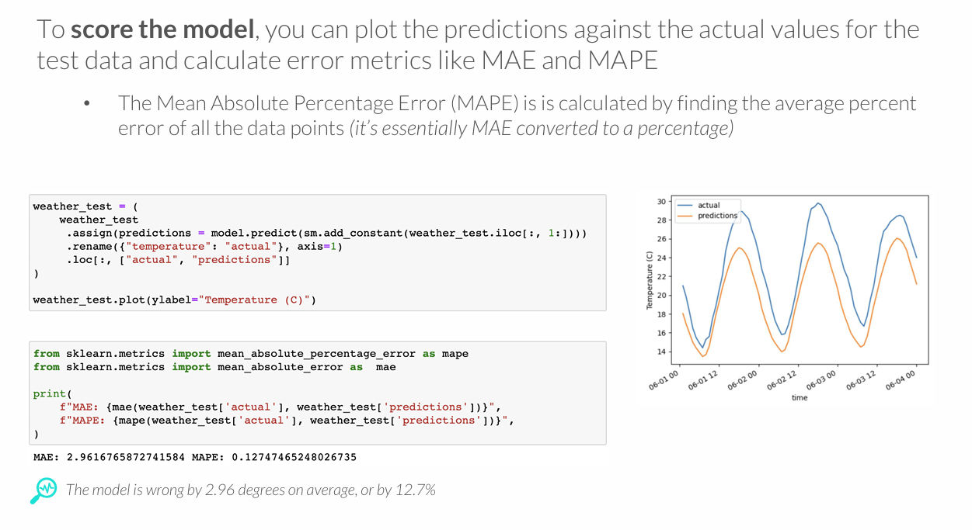
SCORING THE MODEL

Slide 34
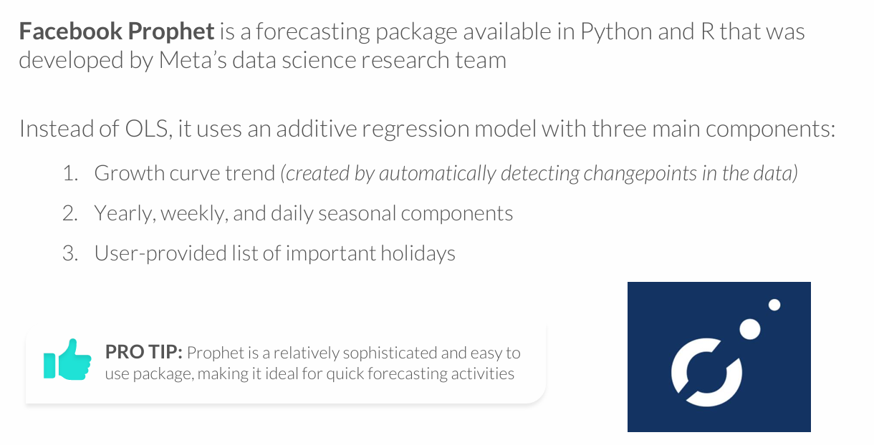
FACEBOOK PROPHET

Slide 35
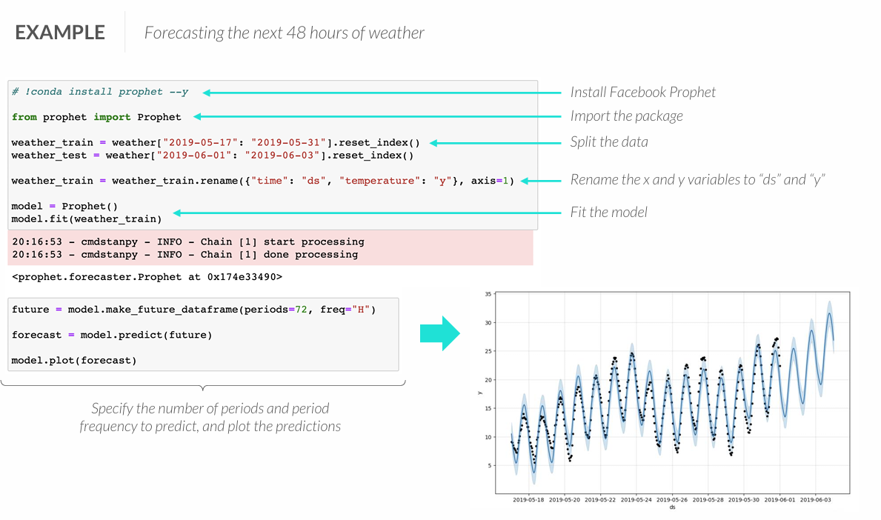
FACEBOOK PROPHET

Slide 36
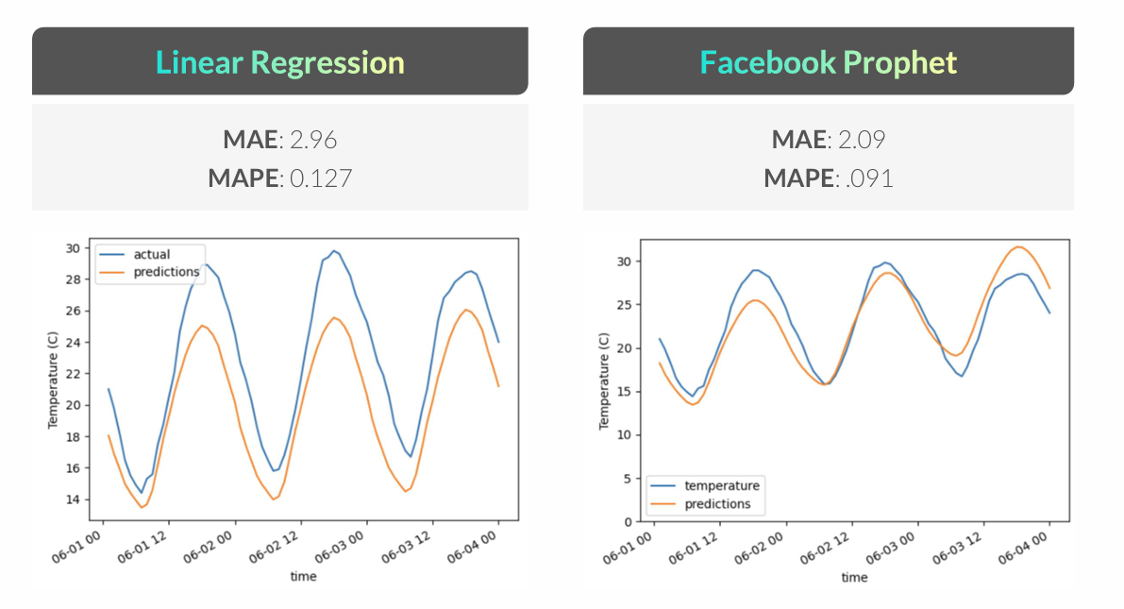
LINEAR REGRESSION VS. PROPHET

Slide 37
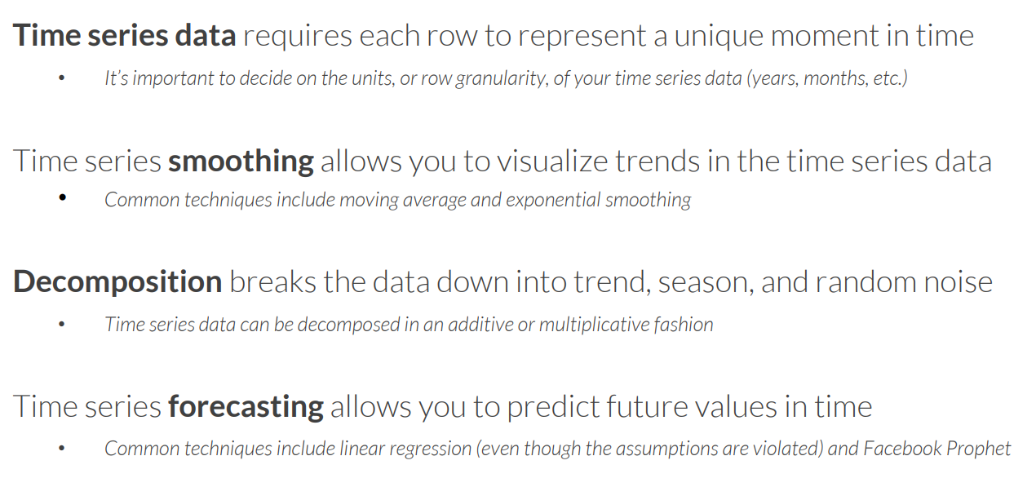
Key Takeaways

